Slide 1
Session Tracking Mechanisms

Slide 2
Objective
To learn
Why session tracking is needed?
Different session tracking mechanisms

Slide 3
Outcome
Students will be able to
Write three tier web application using any session tracking mechanism

Slide 4
Context
Servlet is the java program or module resides in the server to process the request
Since HTTP protocol is maintaining the state of the user, session tracking mechanisms are used to maintain the state of the user

Slide 5
Sessions
Many interactive Web sites spread user data entry out over several pages:
Ex: add items to cart, enter shipping information, enter billing information
Problem: how does the server know which users generated which HTTP requests?
Cannot rely on standard HTTP headers to identify a user

Slide 6
Sessions
Session simply means a particular interval of time.
Session Tracking is a way to maintain state (data) of an user. It is also known as session management in servlet.
Http protocol is a stateless so we need to maintain state using session tracking techniques
Each time user requests to the server, server treats the request as the new request.

Slide 7
Session tracking techniques
There are four techniques used in Session tracking
HttpSession
Cookies
Hidden Form Field
URL Rewriting

Slide 8
Session Tracking Mechanism - HttpSession

Slide 9
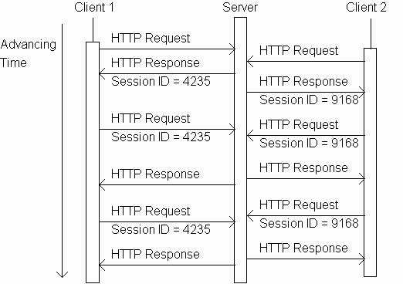
Sessions tracking using session object

Slide 10
Sessions tracking using session object
Server sends back
new unique
session ID when
the request has
none

Slide 11
Sessions tracking using session object
Client that supports
session stores the
ID and sends it
back to the server
in subsequent
requests

Slide 12
Sessions tracking using session object
Server knows
that all of these
requests are
from the same
client. The
set of requests
is known as a
session.

Slide 13
Sessions tracking using session object
And the server
knows that all
of these
requests are
from a different
client.

Slide 14
Methods and Description
public boolean isNew()
returns true if the session is true otherwise false
public String getId()
returns a string containing the unique identifier assigned to the session
public long getCreationTime()
returns the time when this session was created
public long getLastAccessedTime()
returns the last time the client sent a request associated with this session
public void setAttribute(String name, Object value)
Binds an object to this session, using the name specified

Slide 15
Methods and Description
public Object getAttribute(String name)
method returns the object bound with the specified name in this session, or null if no object is bound under the name
public Enumeration getAttributeNames()
This method returns an Enumeration of String objects containing the names of all the objects bound to this session
public int getMaxInactiveInterval()
returns the maximum time interval, in seconds, that the servlet container will keep this session open between client accesses
public void invalidate()
This method invalidates this session and unbinds any objects bound to it

Slide 16

Session Attributes
Code in DoGet() Method
response.setContentType("text/plain");
PrintWriter out = response.getWriter();
// Create a session object
HttpSession session = request.getSession(true);
// Get session creation time.
Date createTime = new Date(session.getCreationTime());
// Get last access time of this web page.
Date lastAccessTime =
new Date(session.getLastAccessedTime());
out.println("Session Id:"+session.getId());
out.println("Date of session creation:"+createTime);
out.println("Last Accessed Time:"+lastAccessTime);
Output

Slide 17
How to check whether the session is new or not?
public class CountServlet extends HttpServlet {
int visits=0;
public void doGet(...)
{
HttpSession session = req.getSession(true);
if(session.isNew())
out.println(“Welcome to the website”);
else
out.println(“Welcome back”);}}

Slide 18
Example for HTTP Session
Set the attribute in the session scope in one servlet and get that value from the session scope in another servlet
To set the attribute in the session scope, setAttribute() method of HttpSession is used
To get the attribute in the session scope, getAttribute method is used

Slide 19
Example for HTTP Session
request.getSession(true) returns current session. If current session does not exist, then it will create a new session
request.getSession(false) returns current session if current session exists, then it will not create a new session
Index.html
<form action="servlet1">
Name:<input type="text" name="userName"/><br/>
<input type="submit" value="go"/>
</form>

Slide 20
FirstServlet.java
import java.io.*; import javax.servlet.*; import javax.servlet.http.*;
public class FirstServlet extends HttpServlet {
public void doGet(HttpServletRequest request, HttpServletResponse response){
try{ response.setContentType("text/html");
PrintWriter out = response.getWriter();
String n=request.getParameter("userName");
out.print("Welcome "+n);
HttpSession session=request.getSession();
session.setAttribute("uname",n);
out.print("<a href='servlet2'>visit</a>");
out.close();
}catch(Exception e){System.out.println(e);} } }

Slide 21
SecondServlet.java
import java.io.*;
import javax.servlet.*;
import javax.servlet.http.*;
public class SecondServlet extends HttpServlet {
public void doGet(HttpServletRequest request, HttpServletResponse response)
try{
response.setContentType("text/html");
PrintWriter out = response.getWriter();
HttpSession session=request.getSession(false);
String n=(String)session.getAttribute("uname");
out.print("Hello "+n);
out.close();
}catch(Exception e){System.out.println(e);} } }

Slide 22
Session Tracking Mechanism - Cookies

Slide 23
What is Cookie?
A cookie
– small piece of information that is persisted between the multiple client requests
A cookie has name and value

Slide 24


How Cookie works?
By default, each request is considered as a new request
Cookie is added with response from the servlet
Cookie is stored in the cache of the browser
Request is sent by the user, cookie is added with request by default
Recognize the user as the old user.

Slide 25
Advantages & Disadvantages
Advantage of Cookies
Simplest technique of maintaining the state
Cookies are maintained at client side
Disadvantage of Cookies
It will not work if cookie is disabled from the browser
Only textual information can be set in Cookie object

Slide 26
Constructors & Methods
Constructor | Description
Cookie() | constructs a cookie.
Cookie(String name, String value) | constructs a cookie with a specified name and value.
Method | Description
public void setMaxAge(int expiry) | Sets the maximum age of the cookie in seconds.
public String getName() | Returns the name of the cookie. The name cannot be changed after creation.
public String getValue() | Returns the value of the cookie.
public void setName(String name) | changes the name of the cookie.
public void setValue(String value) | changes the value of the cookie.

Slide 27
Creation and Deletion of Cookies
How to create Cookie?
Cookie ck=new Cookie("user","sonoo jaiswal");//creating cook ie object
response.addCookie(ck);//adding cookie in the response
How to delete Cookie?
Cookie ck=new Cookie("user","");//deleting value of cookie ck.setMaxAge(0);//changing the maximum age as 0 response.addCookie(ck);//adding cookie in the response

Slide 28
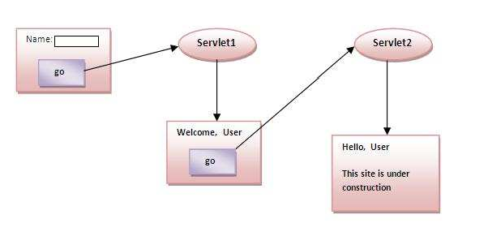
How to get Cookies?
Cookie ck[]=request.getCookies();
for(int i=0;i<ck.length;i++)
{
out.print("<br>"+ck[i].getName()+" "+ck[i].getValue());
}
Storing the name of the user in the cookie object and accessing it in another servlet

Slide 29
Cookie Example1 – web.xml
<web-app>
<servlet>
<servlet-name>s1</servlet-name>
<servlet-class>FirstServlet</servlet-
class>
</servlet>
<servlet-mapping>
<servlet-name>s1</servlet-name>
<url-pattern>/servlet1</url- pattern>
</servlet-mapping>
<servlet>
<servlet-name>s2</servlet-name>
<servlet-
class>SecondServlet</servlet- class>
</servlet>
<servlet-mapping>
<servlet-name>s2</servlet-name>
<url-pattern>/servlet2</url- pattern>
</servlet-mapping>
</web-app>

Slide 30
Cookie Example1 – FirstServlet
public class FirstServlet extends HttpServlet {
public void doPost(HttpServletRequest request, HttpServletResponse response){
try{response.setContentType("text/html"); PrintWriterout=response.getWriter();
String n=request.getParameter("userName"); out.print("Welcome "+n);
Cookie ck=new Cookie("uname",n);//creating cookie object response.addCookie(ck);//adding cookie in the response
//creating submit button out.print("<formaction='servlet2'>");
out.print("<input type='submit' value='go'>"); out.print("</form>");
out.close();
}catch(Exception e){System.out.println(e);}
}
}

Slide 31
Cookie Example1 – SecondServlet
public class SecondServlet extends HttpServlet {
public void doPost(HttpServletRequest request, HttpServletR esponse response){
try{ response.setContentType("text/html"); PrintWriter out = response.getWriter(); Cookie ck[]=request.getCookies(); out.print("Hello "+ck[0].getValue()); out.close();
}catch(Exception e){System.out.println(e);}
}
}

Slide 32
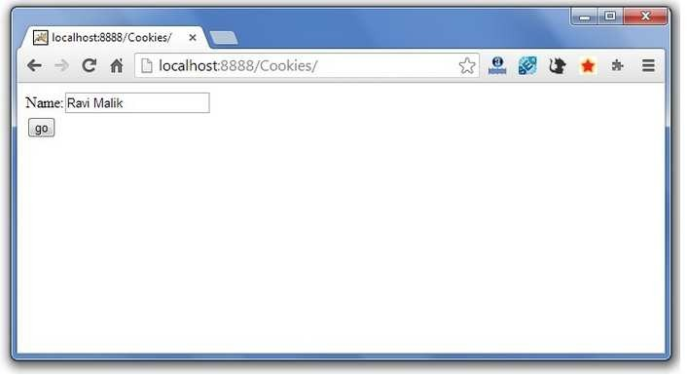
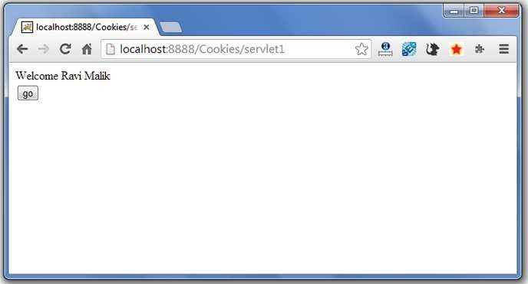
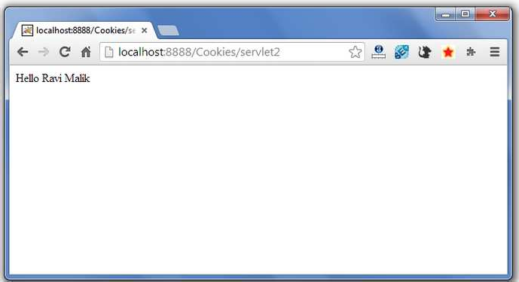
Cookie Example1 – SecondServlet
Index.html
<form action="servlet1" method="post">
Name:<input type="text" name="userName"/><br/>
<input type="submit" value="go"/>
</form>

Slide 33
Session Tracking Mechanism – Hidden Form Field

Slide 34
What is hidden field?
hidden (invisible) textfield
used for maintaining the state of an user
Store the information in the hidden field and get it from another servlet
This approach is better if we have to submit form in all the pages and we don't want to depend on the browser.
Example
<input type="hidden" name="uname" value=“Sharan ">

Slide 35
Advantages & Disadvantages
Advantage of Hidden Form Field
It will always work whether cookie is disabled or not.
Disadvantage of Hidden Form Field:
It is maintained at server side
Extra form submission is required on each page
Only textual information can be used

Slide 36
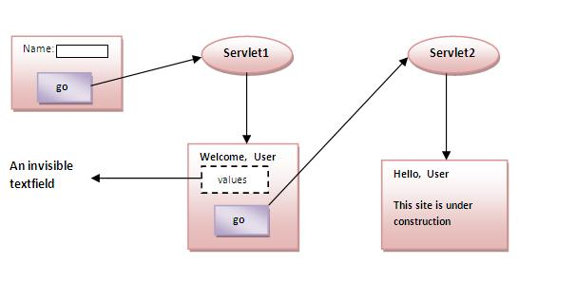
Example of Hidden Form Field

Slide 37
Hidden Form Example – web.xml
<servlet>
<servlet-name>s2</servlet-name>
<servlet-class>SecondServlet</servlet-class>
</servlet>
<servlet-mapping>
<servlet-name>s2</servlet-name>
<url-pattern>/servlet2</url-pattern>
</servlet-mapping>
</web-app>
<web-app>
<servlet>
<servlet-name>s1</servlet-name>
<servlet-class>FirstServlet</servlet-class>
</servlet>
<servlet-mapping>
<servlet-name>s1</servlet-name>
<url-pattern>/servlet1</url-pattern>
</servlet-mapping>

Slide 38
Hidden Form Example – FirstServlet
public class FirstServlet extends HttpServlet {
public void doGet(HttpServletRequest request, HttpServletResponse response){
try{
response.setContentType("text/html");
PrintWriter out = response.getWriter();
String n=request.getParameter("userName");
out.print("Welcome "+n);
//creating form that have invisible textfield
out.print("<form action='servlet2'>");
out.print("<input type='hidden' name='uname' value='"+n+"'>");
out.print("<input type='submit' value='go'>");
out.print("</form>");
out.close();
}catch(Exception e){System.out.println(e);}
}
}

Slide 39
Hidden Form Example – SecondServlet
import java.io.*;
import javax.servlet.*;
import javax.servlet.http.*;
public class SecondServlet extends HttpServlet {
public void doGet(HttpServletRequest request, HttpServletResponse response)
try{
response.setContentType("text/html");
PrintWriter out = response.getWriter();
//Getting the value from the hidden field
String n=request.getParameter("uname");
out.print("Hello "+n);
out.close();
}catch(Exception e){System.out.println(e);}
}
}

Slide 40
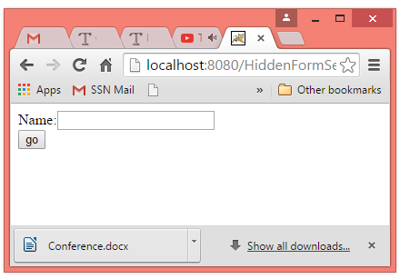
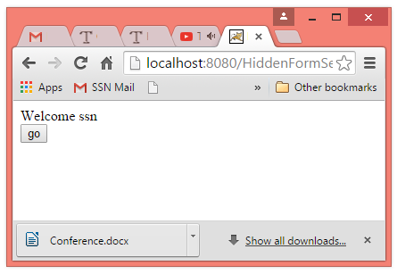
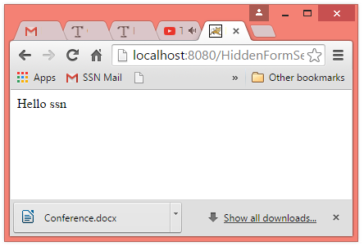
Hidden Form Example – Output
Index.html
<form action="servlet1">
Name:<input type="text" name="userName"/><br/>
<input type="submit" value="go"/>
</form>

Slide 41
Session Tracking Mechanism – Url Rewriting

Slide 42
URL Rewriting
In URL rewriting, token or an identifier is appended to the URL of the next Servlet or the next resource.
Can send parameter name/value pairs using the following format:
url?name1=value1&name2=value2&??
When the user clicks the hyperlink, the parameter name/value pairs will be passed to the server.
From a Servlet, we can use getParameter() method to obtain a parameter value.

Slide 43
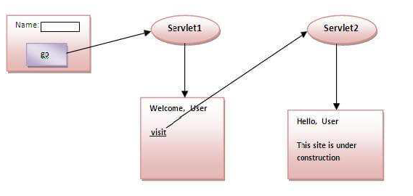
URL Example

Slide 44
Advantages & Disadvantages
Advantage of URL Rewriting
It will always work whether cookie is disabled or not (browser independent).
Extra form submission is not required on each pages.
Disadvantage of URL Rewriting
It will work only with links.
It can send Only textual information.

Slide 45
URL Rewriting Example
Index.html
<form action="servlet1">
Name:<input type="text" name="userName"/><br/>
<input type="submit" value="go"/>
</form>

Slide 46
Firstservlet.java
import java.io.*; import javax.servlet.*; import javax.servlet.http.*;
public class FirstServlet extends HttpServlet {
public void doGet(HttpServletRequest request, HttpServletResponse response){
try{
response.setContentType("text/html");
PrintWriter out = response.getWriter();
String n=request.getParameter("userName");
out.print("Welcome "+n);
//appending the username in the query string
out.print("<a href='servlet2?uname="+n+"'>visit</a>");
out.close();
}catch(Exception e){System.out.println(e);} } }

Slide 47
SecondServlet.java
import java.io.*; import javax.servlet.*; import javax.servlet.http.*;
public class SecondServlet extends HttpServlet {
public void doGet(HttpServletRequest request,
HttpServletResponse response)
try{
response.setContentType("text/html");
PrintWriter out = response.getWriter();
//getting value from the query string
String n=request.getParameter("uname");
out.print("Hello "+n);
out.close();
}catch(Exception e){System.out.println(e);} } }

Slide 48
Simple Questions
Why session tracking is needed?
What are the different techniques?
Write the difference between request.getSession(true) and request.getSession(false)
Which session mechanisms are maintaining the state of the information in the server?
Which session mechanisms are maintaining the state of the information in the cache of the browser?

Slide 49
References
Deitel and Deitel and Nieto, ―Internet and World Wide Web - How to Program‖, Prentice Hall, 5th Edition, 2011.
Jeffrey C and Jackson, ―Web Technologies A Computer Science Perspective‖, Pearson Education, 2011.
Javatpoint tutorial page

Slide 50
Summary
Students will be able to
Write three tier web application using any session tracking mechanism

